Slide 1
Agile Methodologies & Useful GitHub Tools
Presented at ATPESC 2019
James M. Willenbring Senior Member of R&D Technical Staff Sandia National Laboratories
See slide 2 for license details

Slide 2
License, citation, and acknowledgments
License and Citation
This work is licensed under a Creative Commons Attribution 4.0 International License (CC BY 4.0).
Requested citation: James M. Willenbring, Agile Methodologies & Useful GitHub Tools, tutorial, in Argonne Training Program on Extreme-Scale Computing (ATPESC) 2019. DOI: TBD.
Acknowledgements
This work was supported by the U.S. Department of Energy Office of Science, Office of Advanced Scientific Computing Research (ASCR), and by the Exascale Computing Project (17-SC-20-SC), a collaborative effort of the U.S. Department of Energy Office of Science and the National Nuclear Security Administration.
Sandia National Laboratories is a multimission laboratory managed and operated by National Technology and Engineering Solutions of Sandia, LLC, a wholly owned subsidiary of Honeywell International, Inc., for the U.S. Department of Energy’s National Nuclear Security Administration under contract DE-NA0003525. SAND2019-9328 TR.
This work was performed in part at the Oak Ridge National Laboratory, which is managed by UT-Battelle, LLC for the U.S. Department of Energy under Contract No. DE-AC05-00OR22725.

Slide 3
What is Agile?
Agile is not a software development lifecycle model
I’ve seen Agile informally defined as
I don’t write documentation
I don’t do formal requirements, design, or really test…
Agile is not an excuse to do sloppy work
Some people consider agile to be synonymous with Scrum
From Atlassian: Scrum is a framework that helps teams work together
Scrum is Agile, Agile is not (only) Scrum
A square is a rectangle, not all rectangles are squares
Agile is not Kanban either

Slide 4
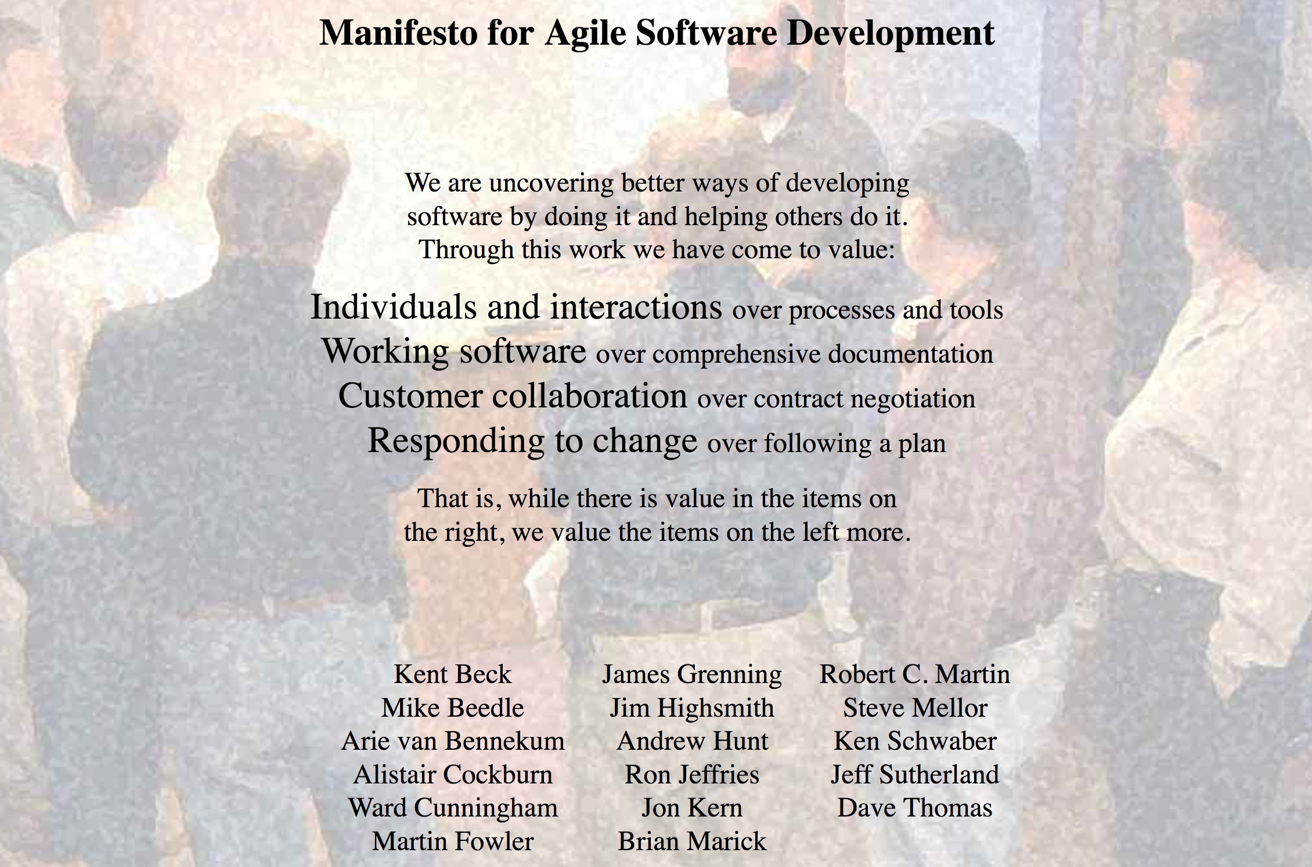
What is Agile?
http://agilemanifesto.org/

Slide 5
Principles behind the Agile Manifesto
Our highest priority is to satisfy the customer through early and continuous delivery of valuable software.
Welcome changing requirements, even late in development. Agile processes harness change for the customer's competitive advantage.
Deliver working software frequently, from a couple of weeks to a couple of months, with a preference to the shorter timescale.
Business people and developers must work together daily throughout the project.
Build projects around motivated individuals. Give them the environment and support they need, and trust them to get the job done.
The most efficient and effective method of conveying information to and within a development team is face-to-face conversation.

Slide 6
Principles behind the Agile Manifesto
Simplicity--the art of maximizing the amount of work not done--is essential.
The best architectures, requirements, and designs emerge from self-organizing teams.
At regular intervals, the team reflects on how to become more effective, then tunes and adjusts its behavior accordingly.
Working software is the primary measure of progress.
Agile processes promote sustainable development. The sponsors, developers, and users should be able to maintain a constant pace indefinitely.
Continuous attention to technical excellence and good design enhances agility.

Slide 7
Why Agile?
Well adept to scientific software efforts (when tailored correctly)
Lighter-weight than “traditional” approaches
Provides meaningful structure that promotes
Productivity
Productization
Sustainability
Flexibility in requirements
Communication

Slide 8
Getting Started with Agile
Agile principles are not hard and fast rules
Try adopting a few Agile practices
Following a rigid, ill-fit framework usually leads to failure
Kanban is a good starting framework
Follow basic principles, add practices when advantageous
Better than removing elements from Scrum
Task: Have Eureka moment by Tuesday.
Scrum

Slide 9
Kanban principles
Limit number of “In Progress” tasks
Must be tuned by each team
Common convention: 2n-1 tasks where n = # team members
Productivity improvement:
Optimize “flexibility vs swap overhead” balance. No overcommitting.
Productivity weakness exposed as bottleneck. Team must identify and fix the bottleneck.
Effective in R&D setting. Avoids a deadline-based approach. Deadlines are dealt with in a different way.
Provides a board for viewing and managing issues

Slide 10
Basic Kanban
Backlog | Ready | In Progress | Done
Any task idea Trim occasionally Source for other columns | Task + description of how to do it. Could be pulled when slot opens. Typically comes from backlog. | Task you are working on right now. The only Kanban rule: Can have only so many “In Progress” tasks. Limit is based on experience, calibration. Key: Work is pulled. You are in charge! | Completed tasks. Record of your life activities. Rate of completion is your “velocity”.
Notes:
Ready column is not strictly required, sometimes called “Selected for development”.
Other common column: In Review
Can be creative with columns:
Waiting on Advisor Confirmation.
Blocked

Slide 11

Personal Kanban
Personal Kanban: Kanban applied to one person.
Apply Kanban principles to your life.
Fully adaptable.
Personal Kanban: Commercial book/website.
Useful, but not necessary.
http://www.personalkanban.com

Slide 12
Kanban tools
Wall, whiteboard, blackboard: Basic approach.
Software, cloud-based:
Trello, JIRA, GitHub Issues.
Many more.
I use Trello (browser, Android, iPhone, iPad).
Can add, view, update, anytime, anywhere.
Different boards for different contexts
Effective when people are split on multiple projects

Slide 13
Big question: How many tasks?
Personal question.
Approach: Start with 2 or 3. See how it goes.
Use a freeway traffic analogy:
Does traffic flow best when fully packed? No.
Same thing with your effectiveness.
Spend time consulting board regularly.
Brings focus.
Enables reflection, retrospection.
Use slack time effectively.
When you get out of the habit, start up again.
Steers towards previously started tasks

Slide 14
Importance of “In Progress” concept for you
Junior community members:
Less control over tasks.
Given by supervisor.
In Progress column: Protects you.
If asked to take on another task, respond:
Is this important enough to
back-burner a, b, and c?
become less efficient?
Sometimes it is.

Slide 15
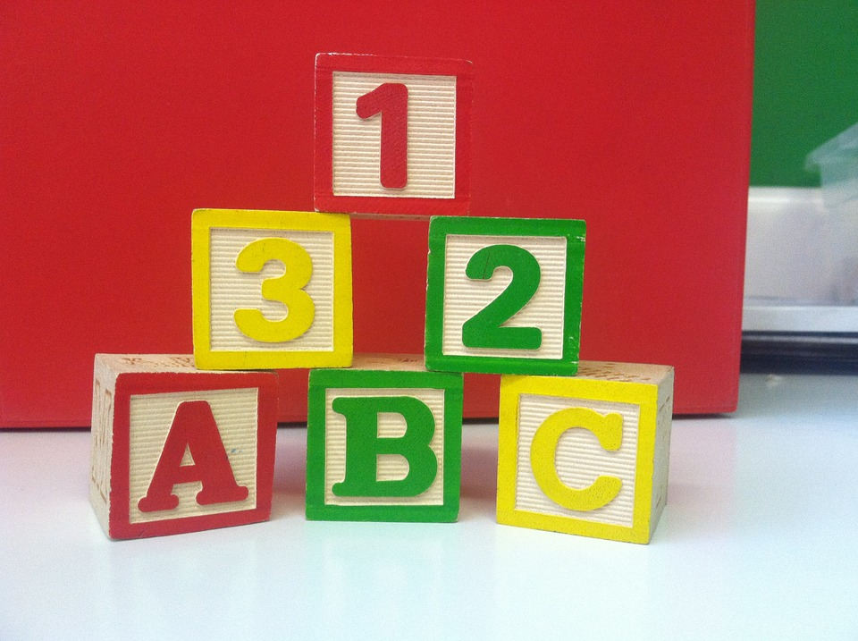
Building on Kanban
Focus: Solve issues!
(not add process)
Stand-ups
Maybe not daily
Planning meetings
Retrospectives
Scrum Master
Product Owner
Epic, story, task
Definition of Done

Slide 16
Building on Kanban
Epic, Story, Task
Formal or informal
Start with high-level requirements
Break down and refine as needed
Example:
Add a validation test suite → Add test harness, add test A, B, etc.

Slide 17

Building on Kanban
A-Team Tools: A collection of resources for understanding and applying lightweight agile practices to your scientific SW project
Especially useful for
Small teams
Teams of teams
Teams that frequently have members come and go
https://betterscientificsoftware.github.io/A-Team-Tools/

Slide 18
Samples from Collegeville Org: Kanban Board

Slide 19
Kanban in GitHub
GitHub supports basic Agile development workflows
Filing issues
@mention
Kanban board
Projects
GitHub lacks more advanced features
Dependencies between issues
You can reference one issue in another
Advanced notification schemes
Custom fields
You can create custom labels

Slide 20
Step 1: Create Issues-only GitHub repo
Go to https://github.com/username
Example: https://github.com/maherou
Create new repo:
Click on “+” (upper right).
Select New repository and enter a name e.g., Issues
Select Public. In real life, this repo is often private (requires $ or special status)
Init with README; don’t add .gitignore or license.
Click Create Repository.
Note: You can add collaborators
Settings -> Collaborators
Type GitHub ID (not email address).

Slide 21
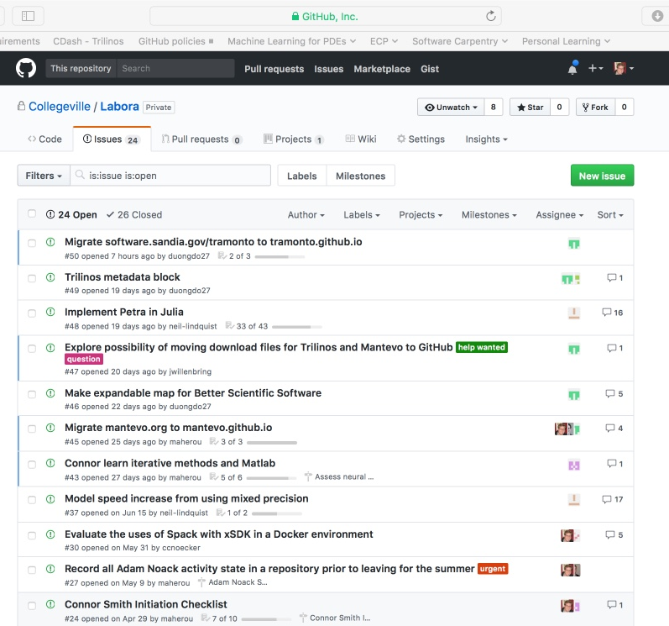
Step 2: Create Issues
Select the Issues tab.
Click on New Issue.
Type in task statement
Type in title only.
Also useful: Labels
Categories for grouping issues by type.
Click Submit new issue
Repeat.

Slide 22
Step 3: Create Kanban Board
Select Projects tab
Click New Project
Use title
Team Kanban board
Add these columns:
Backlog, Ready, In progress, In review, Done.
Click on +Add cards (upper right).
Move each issue to the proper Kanban column

Slide 23
Next Steps: Real Life
Create a GitHub Org and set of repos for your team:
Each team member has an individual repo.
Each project has a repo.
One special repo for issues.
Track all work:
Use checklists for initiation, exit, any big new effort.
Create Kanban board. Keep it current.
Aggregate related issues using milestones.
Drive meetings using Kanban board.
Adapt this approach to meet your needs.
When you start to get sloppy, get back on track.

Slide 24
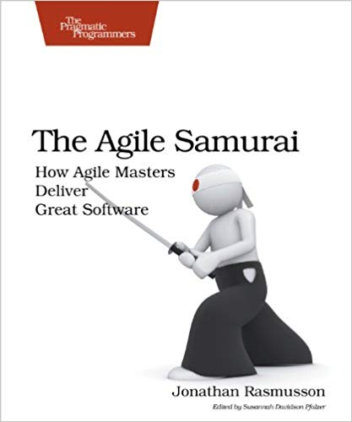
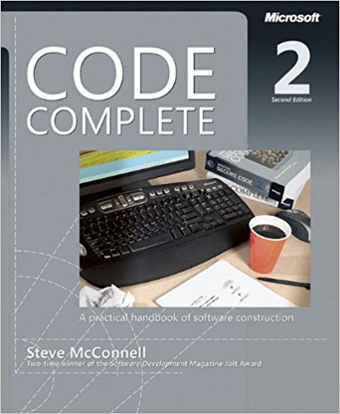

Other Resources
The Agile Samurai: How Agile Masters Deliver Great Software (Pragmatic Programmers), Jonathan Rasmusson.
http://a.co/eUGIe95
Excellent, readable book on Agile methodologies.
Also available on Audible.
Code Complete: A Practical Handbook of Software Construction, Steve McConnell.
http://a.co/eEgWvKj
Great text on software.
Construx website has large collection of content.
Getting Things Done: The Art of Stress-Free Productivity, David Allen
http://a.co/22EPvt6
A classic in the personal productivity literature

Slide 25
Managing issues: Fundamental software process
Continual improvement
Issue: Bug report, feature request
Approaches:
Short-term memory, office notepad
ToDo.txt on computer desktop (1 person)
Issues.txt in repository root (small co-located team)
…
Web-based tool + Kanban (distributed, larger team)
Web-based tool + Scrum (full-time dev team)
Informal, less
training
Formal, more
training

Slide 26
Key Team Management Elements
Checklists:
Initiation, Transition, Exit
Policies:
How team conducts its work
Issue tracking system:
All work tracked, visible to team
Milestones: Aggregate related issues.
Kanban board
Regular meetings, updates

Slide 27
Project: ATPESC Eigen
Four tasks:
Define requirements.
Develop design document.
Write test driver.
Write source code to make test pass.
Notes:
You will have many tasks in a real project.
Tasks are called issues in GitHub.
Good reference: The Agile Samurai

